Slide 1
Hypothesis Testing and Le Cams Method
Information Theory and Coding Techniques Term project
Joel Antony Thomas
17EC10023

Slide 2
Nomenclature
Hypothesis testing is an act in statistics whereby an analyst tests an assumption regarding a population parameter. The methodology employed by the analyst depends on the nature of the data used and the reason for the analysis. Hypothesis testing is used to assess the plausibility of a hypothesis by using sample data. Such data may come from a larger population, or from a data-generating process. The word "population" will be used for both of these cases in the following descriptions.

Slide 3
How Hypothesis Testing Works
In hypothesis testing, an analyst tests a statistical sample, with the goal of providing evidence on the plausibility of the null hypothesis. Statistical analysts test a hypothesis by measuring and examining a random sample of the population being analyzed. All analysts use a random population sample to test two different hypotheses: the null hypothesis and the alternative hypothesis.

Slide 4
Null Hypothesis (H₀)
The null hypothesis H₀ represents a theory that has been put forward either because it is believed to be true, or because it is used as a basis for an argument and has not been proven.
Eg : In a clinical trial of a new drug, the null hypothesis may be that the new drug is of the same effect(on average) as the current drug. In this example,
H₀ : there is no difference between the two drugs(on average)

Slide 5
Alternate Hypothesis (H_{A})
Alternative hypothesis is a position that states something is happening, in which a new theory is preferred instead of the old one (Null hypothesis). We will take the same case as we did for the Null hypothesis, ie, the new Vs old drug example.
The alternate hypothesis may be that the new drug has a different effect (on average), compared to that of the current drug. Note here that, we can have infinite possibilities for the alternate hypothesis. The thing to look out for is that, they should be mutually exclusive, and only one can be true (and one of the hypothesis will always be true). One such example is:
H_{A} : the new drug is better than the current drug (on average)

Slide 6
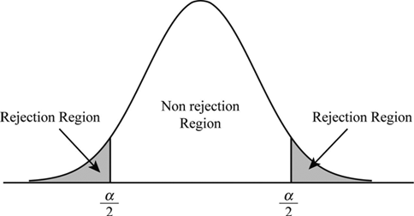
Significance Level (α)
We need to decide on a criterion for accepting or rejecting the Null hypothesis. This is where Significance level comes into the picture.
Significance Level (α) refers to the percentage of sample means that is outside certain prescribed limits.
If α = 5, the nomenclature used will be : testing a hypothesis at 5% level of significance. This means that we reject the null hypothesis if it falls in the two regions of areas of 0.05/2.
So, both the regions on either side of the extreme will be for Alternate hypothesis(grey area), while the area in between is for the Null hypothesis(white area).
For our particular example, we took α = 5.

Slide 7
General procedure of Hypothesis Testing
All hypotheses are tested using the following steps:
The first step is for the analyst to state the two hypotheses so that only one can be right.
The second step is to decide on a value for Significance level, so we can test our hypothesis against the sample.
The third step is to carry out the plan and physically analyze the sample data.
The fourth and final step is to analyze the results and either reject the null hypothesis, or state that the null hypothesis is plausible, given the data.

Slide 8

Real-World Example of Hypothesis Testing
Test : a coin has exactly a 50 percent chance of landing on heads
H₀ : 50 percent is correct (P = 0.5)
H_{A} : 50 percent is not correct (P ≠ 0.5)
Let's assume that we did 100 flips for this experiment. We now test the hypothesis based on the results of this experiment. We will look at two different results to better understand.
Let's take our Significance Level (α) = 5%.
We take a simple real world example to understand how we go about tackling problems, and how we navigate the 4 steps of hypothesis testing.
We take the example of coin flipping.

Slide 9
Real-World Example of Hypothesis Testing
Result 1 : It is found that the 100 coin flips were distributed as 40 heads and 60 tails.
Inference 1 : Since α = 0.05, we could have accepted values from (50 - α/2) heads to (50 + α/2) head, ie, from 47.5 heads to 52.5 heads. However, our results fall outside this region.
Conclusion 1 : We reject the Null hypothesis, and accept the alternate hypothesis, ie, the coin doesn’t have a 50% chance of landing on heads.
Result 2 : It is found that the 100 coin flips were distributed as 48 heads and 52 tails.
Inference 2 : Using the same logic and α value as before, we find that our results lie in the region of acceptance (since 48 > 47.5)
Conclusion 2 : We accept the Null hypothesis, ie, the coin has a 50% chance of landing on heads.

Slide 10
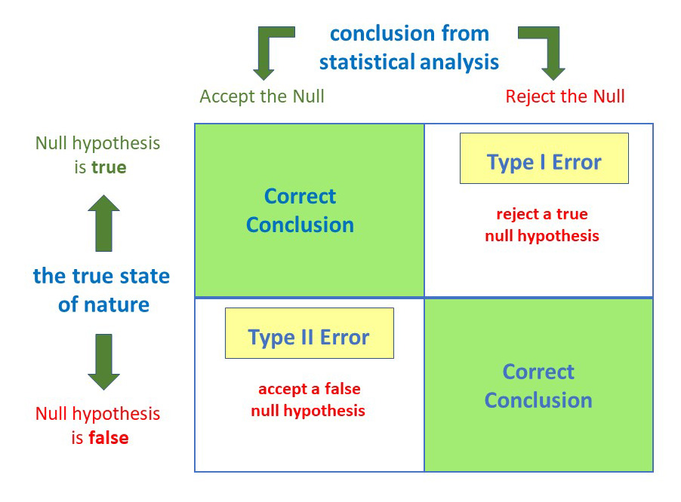
Type I and Type II Error
Type I error is the mistaken rejection of an actually true null hypothesis (also known as a "false positive" finding or conclusion).
Eg : H₀ = There is no difference between the two drugs on average. Type 1 error will occur if we conclude that the two drugs produce different effects when there actually isn't a difference.
The probability of making a Type I Error is the significance level, denoted by alpha(α).
Type II error is the mistaken acceptance of an actually false null hypothesis (also known as a "false negative" finding or conclusion).
Eg : H₀ = There is no difference between the two drugs on average
Type 2 error will occur if we conclude that the two drugs produce the same effect when actually there is a difference.

Slide 11
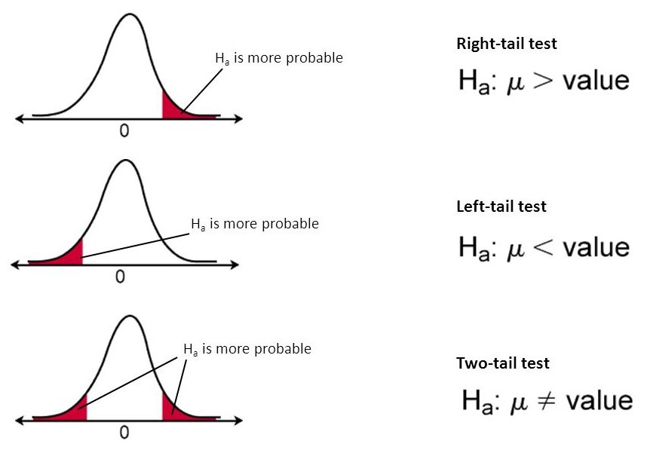
Hypothesis testing for population mean (critical value approach)
Step 1: State Null Hypothesis.
H₀ : µ= µ₀ (where µ₀ is a specified value)
Step 2: State Alternative Hypothesis.
1) H_{a} : µ ≠ µ₀ (two-tailed test)
2) H_{a} : µ > µ₀ (one-tailed test)
3) H_{a} : µ < µ₀ (one-tailed test)
Step 3: State α.
Step 4: Determine Rejection Region.
We have two possibilities here depending on the data given

Slide 12
Hypothesis testing for population mean (critical value approach)
Use when σ is known
Use critical value(z) table
two-tailed (≠) : Reject H₀ if z > z_{α/2} or z < -z_{α/2}
one-tailed (>) : Reject H₀ if z > z_{α}
one-tailed (<) : Reject H₀ if z < z_{α}
Step 5: Calculate the test statistic:
z = (x̅ − μ)
Use when σ is unknown
Use critical value(t) table using df = n - 1
two-tailed (≠): Reject H₀ if t > t_{α/2} or t < -t_{α/2}
one-tailed (>): Reject H₀ if t > t_{α}
one-tailed (<): Reject H₀ if t < − t_{α}
Step 5: Calculate the test statistic:
t = (x̅ − μ)
______
______
(σ/√n)
(s/√n)
Step 6: Determine if the calculated test statistic is in the critical region or not. Reject or Accept H₀.

Slide 13
Hypothesis testing for population mean (critical value approach)
Lets look at an example :
Does the evidence support the idea that the average lecture consists of 3000 words if a random sample of the lectures of 16 professors had a mean of 3472 words, given the population standard deviation is 500 words? Use α = 0.01. Assume that lecture lengths are approximately normally distributed.
1) H₀: µ = 3000
2) H_{a}: µ ≠ 3000
3) α = 0.01
4) Reject H₀ if z < −2.576 or z > 2.576 (We get this from the critical value(z) table)
5) 𝐳 = (3472−3000) / (500 / √16) = 3.78
6) Reject H₀, because 3.78 > 2.576
Hence, the population mean is not equal to 3000 words

Slide 14
Hypothesis testing for population mean (critical value approach)
Lets look at an example when σ isn't given :
The secretary of an association of professional landscape gardeners claims that the average cost of services to customers is $90 per month. Feeling that this figure is too high, we question a random sample of 14 customers. Our sample yields a mean cost of $85 and a standard deviation of $10. Test at the 0.10 significance level. Assume that such costs are normally distributed.
1) H₀: µ = 90
2) H_{a} : µ < 90
3) α = 0.10
4) (df = 13) Reject H₀ if t < −1.350 (We get this value from the critical value(t) table.)
5) 𝐭 = (85−90) / (10 / √14 ) = -1.87
6) Reject H₀, because −1.87 < −1.350
Hence, the population mean is less than $90

Slide 15
Hypothesis testing for population mean (p value approach)
Step 1: State Null Hypothesis.
H₀ : µ= µ₀ (where µ₀ is a specified value)
Step 2: State Alternative Hypothesis.
1) H_{a} : µ ≠ µ₀ (two-tailed test)
2) H_{a} : µ > µ₀ (one-tailed test)
3) H_{a} : µ < µ₀ (one-tailed test)
Step 3: State α.
Step 4: Determine p-value from Minitab printout
Step 5: Compare the p-value with the α value; If P−value ≤ α, reject H₀, otherwise accept H₀.
Lets look at an example to understand this approach.

Slide 16
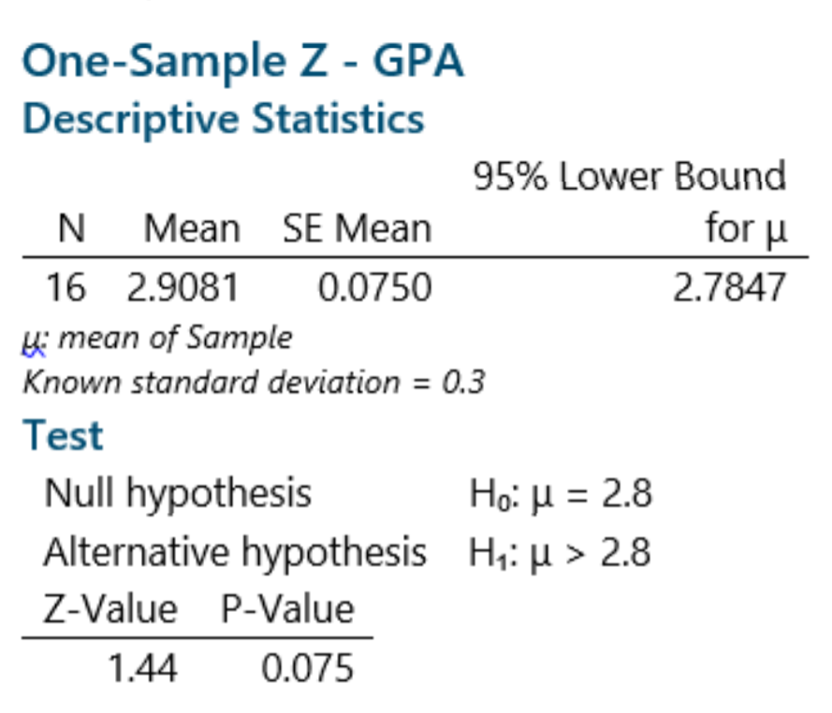
Hypothesis testing for population mean (p value approach)
The mean GPA at a certain university is 2.80 with a population standard deviation of 0.3. A random sample of 16 business students from this university had a mean of 2.91. Test to determine whether the mean GPA for business students is greater than the university mean at the 0.10 level of significance.
1) H₀: µ = 2.8
2) H_{a}: µ > 2.8
3) α = 0.10
4) p-value = 0.075 ( We get this from the minitab)
5) 0.075 < 0.1, hence reject H₀
Hence, the population mean is greater than 2.8.

Slide 17
Binary Hypothesis Testing
In Binary Hypothesis Testing, we will be dealing with two probability distributions. Let us call them P₁ and P₂. We will then choose a sample from either P₁ or P₂ (let us call this nature as V). For simplicity, let it be equal (ie 0.5 each)
V =
1 with probability 0.5
2 with probability 0.5
g(X) is an estimator that operates on X and tells about whether X is from distribution P₁ or P₂.
We can then find ther probability of error as follows :
P_{r}(error) = P₁(g(x) = 2) * P(V = 1) + P₂(g(x) = 1) * P(V = 2)
= 0.5 * (P₁(g(x) = 2) + P₂(g(x) = 1))

Slide 18
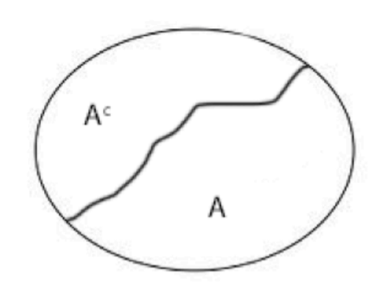
Binary Hypothesis Testing Error
The estimator g() will divide the random variable X into two parts as follows.
A = region where g(x) = 1
A^{c} = region where g(x) = 2
We now find the best probability of error(P_{e}*) :
(P_{e}*) = 0.5 * inf [P₁(A^{c}) + P₂(A)]
Infimum(inf) of a subset S of a partially ordered set P is a greatest element in P that is less than or equal to all elements of S, if such an element exists.
= 0.5 * inf [ 1 – P₁(A) + P₂(A) ]
Since P₁(A^{c}) = 1 – P₁(A)
= 0.5 * [ 1 – sup [ P₁(A) - P₂(A) ] ]
The supremum(sup) of a subset S of a partially ordered set P is the least element in P that is greater than or equal to all elements of S, if such an element exists.

Slide 19
Le Cam's
We define
sup[P₁(A) - P₂(A)] = ||P₁ – P₂||_{TV}
Where TV = Total Variation Distance.
Hence,
P_{e}* = 0.5 * [1 - ||P1 – P2||_{TV} ]
This is the Le Cam's equation.
Observe that the worst case error is 0.5 , which occurs when the total variation distance between P₁ and P₂ is 0, at which point the classifier is random guessing. Conversely, when the data is linearly separable, the total variation between the two distributions is 1, the error is 0
We will now look at an example to understand the concept of Total Variation better.

Slide 20
TV Distance
Let our sample space X = {1, 2, 3}, and
P₁ : P₁(1) = 0.5 P₁(2) = 0.25 P₁(3) = 0.25
P₂ : P₂(1) = 0.3 P₂(2) = 0.3 P₂(3) = 0.4
subset | P₁(A) - P₂(A^{c})
{1} | 0.2
{2} | -0.05
{3} | -0.15
{1, 2} | 0.15
{1, 3} | 0.05
{2, 3} | -0.2
Total Variation(TV) distance is the maximum distance of all the possible subsets of X
Hence,
||P₁ – P₂|| = sup[P₁(A) - P₂(A)]
= 0.2

Slide 21
Properties of TV Distance
Symmetry of TV Distance :
||P₁ – P₂||_{TV} = sup[P₁(A) - P₂(A)]
= sup[1 – P₁(A^{c}) - 1 + P₂(A^{c})]
= sup[P₂(A^{c}) - P₁(A^{c})]
= sup[P₂(B) - P₁(B)]
Where B also belongs to the set X
= ||P₂ – P₁||_{TV}
Similarly, it can be shown that :
1. TV distance is a valid distance 2. ||P₁ – P₂||_{TV} = 0.5 * ||P₁ – P₂||_{l1} l1 = l1 norm
3. TV distance satisfies triangularity property 4. (2 / ln 2) * ||P₁ – P₂||_{TV}² ≤ D(P₁||P₂)
(Pinsker's Inequality)

Slide 22
Multi-class Classification
Let's now look at the case of multi-class classification. Here, instead of two classes(binary), we are faced with multiple classes.
Let's assume
J ~ Uniform(1, 2, 3...M)
(Z|J = j) ~ P_{θj}
We need to determine index j from which the samples have been taken. Of course, the difficulty in this depends on the dependence between Z and index j.
Our goal is to determine the index J of the probability distribution from which a given sample has been drawn. Intuitively, the difficulty of this depends on the amount of dependence between Z and index J.

Slide 23
Fano's Method
Let Q_{Z,J} denote the joint distribution of inputs and labels, and Q_{Z}Q_{J} denote the product of the marginal distributions. If we have
Q_{Z,J} = Q_{Z}Q_{J}
Z and J are statistically independent, which means knowing one of them does not let us infer anything about the other. In this case, the best we can do is random guessing. To quantify the amount of dependence of Z and J we define mutual information I as the Kullback-Leibler divergence:
I(Z, J) = D_{KL}(Q_{Z,J} |Q_{Z}Q_{J} ) ≥ 0
Now Fano’s inequality gives us a lower bound on the classification error:
Q(ψ(P) ≠ J) ≥ 1 − (I(Z, J) + log 2)
_____________
log M
Ψ = the distribution for the probability
This is the Fano's method used for multiple class classification.

Slide 24
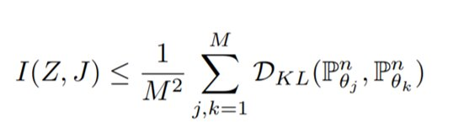
Fano's Method
There are various ways to upper bound the mutual information I(Z, J) in this setting. On way is to use the convexity of the KL-divergence which leads us the following inequality.

Slide 25
Thank You !

